Slide 1
Training
Code co-occurs much
Code (Python)
There was were 4 pizzas that needed to be shared between 8 people, so I gave each person 1/2
def num_pizza_each( pizzas, people):
return pizzas / people
def cost_for_each_pizza(…
>>> Compute_Pizza(4,8)
>>> 1/2
1. Pretraining documents are conditioned on latent concepts (e.g. Addition, Subtraction)
Concept
(e.g. Division)
Inference
If I had 4 apples and gave each person equal amount, how much does each person have?
2. Sample examples conditioned on previous examples and the inferred concept
def num_pizza_each…
If I had 4 apples and two people an equal amount each, how much does each person have?
Prompt
Well, I remember 4 pizzas divided by 8 people is 1/2
def cost_each_for_pizza
Concept
(e.g. Division)
Like the pizzas, I remember splitting the bill
def divide_apples(apples, people)
Chain of Thought
3. Chain of thought helps infer the right concept
Ah yes! We are talking about division.
>>> divide_apples(4,2)
>>> 2
So four divided by two is two.
Answer

Slide 2



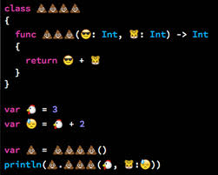


Slide 3
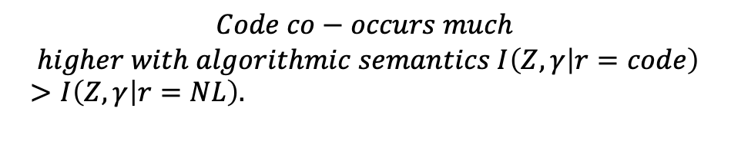



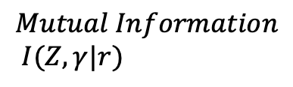







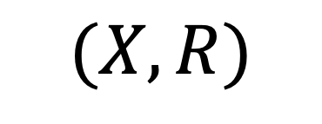


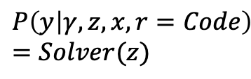


Stage (1): Translate
Stage (2): Execute
Comparison
$$P\left(z | x, r=NL\right)$$
$$P\left(γ | z,x, r=Code\right)$$
$$P\left(y | γ, z, x,r=NL\right)$$
NL CoT
Latent Concept
Answer
(i) First Arm
$$P\left(z | x, r=Code\right)$$
$$P\left(γ | z,x, r=Code\right)$$
$$P\left(y | γ, z,x,r=Code\right)$$
This jump is easier
This jump is hard
NL input
(ii) Second Arm
Code CoT
Latent Concept
Answer
$$(X,R)$$
(iii) Third Arm
$$P\left(y | γ, z,x, r=Code\right)=Solver(z)$$
This jump is easy
$$P\left(z | x, r=Code\right)$$
$$P\left(γ | z,x, r=Code\right)$$
Code CoT
Latent Concept
Answer
$$Z$$
$$γ$$
$$Y$$
Training
Inference
$$Mutual Information$$
$I(Z,γ|r)$
Answer
Pretraining
Code CoT
Concept
$$Code co−occurs much$$
$$higher with algorithmic semantics I\left(Z, γ | r=code\right)>I\left(Z,γ | r=NL\right).$$
$$Z$$
$$γ$$
$$Y$$

Slide 4
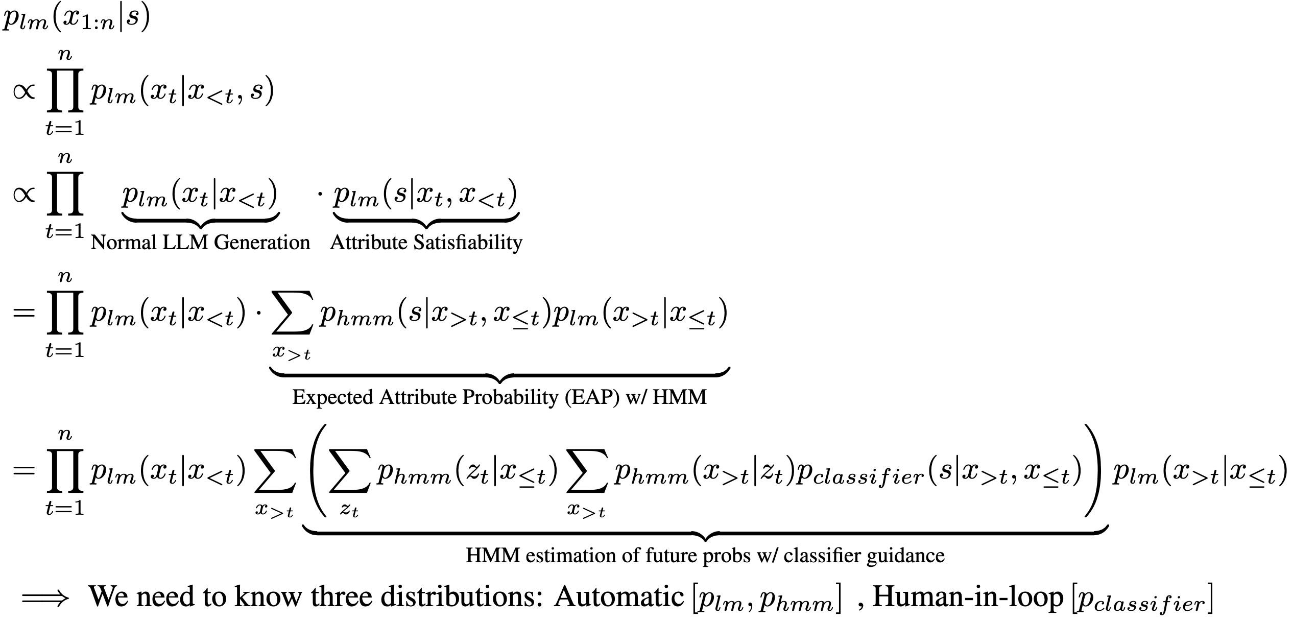

Language Models + HMM Dual
External Utility Estimator
(Plug and Play)
Autoregressive LLM Inference of generating code for tool X, given constraint S
Automatic Learning
Human-in-loop
Efficient
Verifiable
Easy to Integrate
LLM ‘A’ (e.g. ChatGPT)
HMM Distilled
from LLM ‘A’
Tractable Probabilistic Circuit:
Assigns probability 0 to unsatisfiable constraints

Slide 5


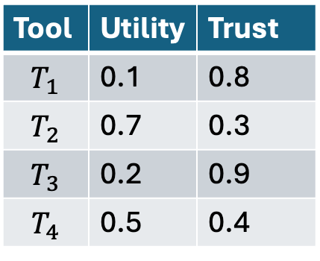



Tools / Entities in environment
Adversary Corruption
Tool | Utility | Trust
$$T_{1}$$ | 0.1 | 0.8
$$T_{2}$$ | 0.7 | 0.3
$$T_{3}$$ | 0.2 | 0.9
$$T_{4}$$ | 0.5 | 0.4
$$T_{1}$$
$$T_{2}$$
How to reason over tools?
Agent
$$T_{3}$$
$$T_{4}$$

Slide 6






Suppose sequence of decisions is of length 3, (either token generation of tool descriptions, or where X directly represents a tool). We just say X is a tool.
Marginal Queries at $T=3⇒P\left(S\right|X_{5}, X_{4}, X_{3}, X_{2} = A, X_{1} = B)$
$$S$$
x
x
x
Output Decision
$$X_{1}$$
+
x
+
x
+
$$X_{2}$$
x
x
+
x
$$X_{3}$$
$$X_{4}$$
$$X_{5}$$
Marginalize over future sequences

Slide 7










The only advantage LM confers is recovery here
Suppose we fail here
$$P\left(z_{code} | x\right)$$
$$P\left(y | z_{code},x\right)$$
Answer $y$
NL Input $x$
Code CoT $z_{code}$
$$P\left(z_{code} | x\right)$$
$$y=Solver(z)$$
Answer $y$
NL Input $x$
Code CoT $z_{code}$
$E_{code}\left[p\left(LM | code\right)−p\left(Solver | code\right)\right]<0$ from the data.
$p\left(Code Wrong\right) ×[p\left(LM Exec Right|Code Wrong\right)−p\left(Solver Right \right|Code Wrong)]$
$p\left(Code Right\right) ×[p\left(LM Exec Right|Code Right\right)−p\left(Solver Right \right|Code Right)]$

Slide 8
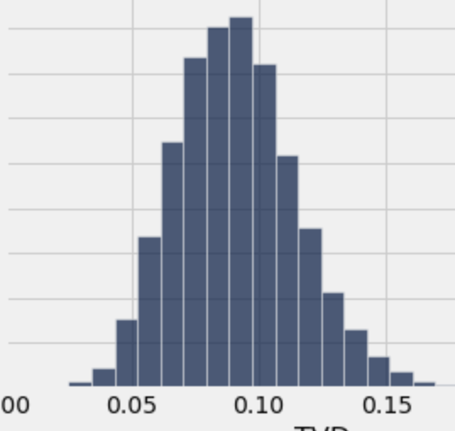
Latents are Identifiable.
P(z| theta, x, r_i = code)
Concept Θ (Addition)
For generating a piece of code: e.g. def add(). For different semantics, the probability of generating this is definitely different (high for addition, low for subtraction)
Concept Θ’ (Addition)
P(z| theta’, x, r_i = code)
P(z| theta, x, r_i = nl)
Concept Θ (Addition)
1. Are we subtracting from Mary, or adding to John?
E.g. Mary Gives John 5 Applies.
Concept Θ’ (Subtract)
P(z| theta’, x, r_i = nl)

Slide 9
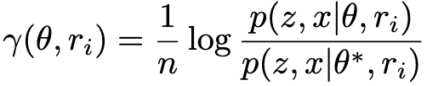
1. Given identifiability of z, we want to show that log likelihood concentrates on the right concept in the limit
1 iff theta is the right answer, otherwise 0
via Asymptotic Equipartition Property of Ergodic Process.
(i.e. generalized Shannon-Mcmillan-Breiman Theorem)

Slide 10
Observed States
def
compute
_amount
_pizza
()
1
2
3
4
5
Hidden States
each transition parameterized by Θ ~ Dirichlet(a), moreover (1) each transition has non-zero probability. (2) we have a finite number of states (3) at least 1 self-loop

